Slide 1
London

Slide 2
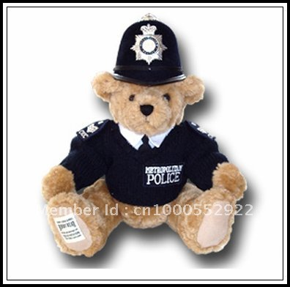
Come and visit London with us!

Slide 3
BUCKINGHAM PALACE

Slide 4
Buckingham Palace has served as the official London residence of Britain's sovereigns since 1837 and today is the administrative headquarters of the Monarch.
Although in use for the many official events and receptions held by The Queen, the State Rooms at Buckingham Palace are open to visitors every year.
Buckingham Palace has 775 rooms. These include 19 State rooms, 52 Royal and guest bedrooms, 188 staff bedrooms, 92 offices and 78 bathrooms. In measurements, the building is 108 metres long across the front, 120 metres deep (including the central quadrangle) and 24 metres high.

Slide 5
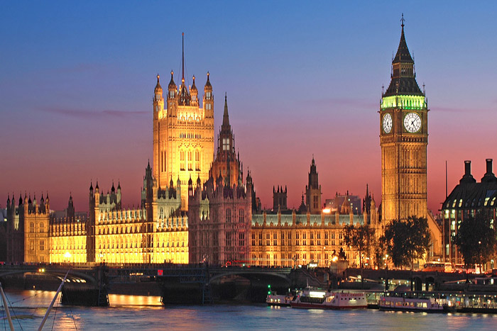
HoUSES OF PARLAMENT AND THE CLOCK TOWER

Slide 6
The Houses of Parliament is the seat of the two parliamentary houses of the United Kingdom: the House of Lords and the House of Commons.
The Palace lies on the northern bank of the River Thames in central London. In 1265 a parliament was created with two houses: the Lords and the Commons. In 1834 a fire destroyed the Palace of Westminster. After the fire, a competition was organized to create a new building for the two houses of parliament. A design by Sir Charles Barry and his assistant Augustus Welby Pugin was chosen.
The most famous part of Charles Barry's design is the clock tower originally called St. Stephen's Tower. It was soon named after the tower's largest bell, the Big Ben. It is the symbol of London.

Slide 7
WESTMINSTER ABBEY

Slide 8
Since 1066, when Harold Godwinson and William the Conqueror were crowned, all British and English kings are crowned there.
Westminster Abbey is a large, mainly Gothic abbey church in the City of Westminster London, located just to the west of the Palace of Westminster. It is one of the most notable religious buildings in the United Kingdom. It was built in 970s.

Slide 9
ST PAUL’S CATHEDRAL

Slide 10
St Paul's Cathedral is an Anglican cathedral and the seat of the Bishop of London.
The cathedral is one of the most famous and most recognisable sights of London. Its dome, framed by the spires dominated the skyline for 300 years. At 365 feet (111 m) high, it was the tallest building in London from 1710 to 1962. The dome is among the highest in the world.
In 962 and again in 1087, the cathedral was destroyed by fire, but each time it was rebuilt and expanded.
Sir Christopher Wren designed the present Baroque –style building.

Slide 11
TRAFALGAR SQUARE

Slide 12
Trafalgar Square, the largest square in London, is often considered the heart of the city. Ever since the Middle Ages, this area has been a central meeting place.
The name of the square commemorates the victory of Admiral Horatio Lord Nelson over the French fleet at the Battle of Trafalgar.
In the middle of the square stands a tall column honoring admiral Nelson. At the base of the column there are four huge lions.
There are also two fountains created as a memorial to two admirals of the Royal Navy.
On the north side there is the neoclassical National Gallery, built between 1834 and 1838.

Slide 13
NATIONAL GALLERY

Slide 14
The National Gallery is an art museum in London. It is situated in the centre of London, in Trafalgar Square
The museum is home to an impressive collection of paintings, spanning six centuries. You can admire works from some of the world's most famous painters, including Rubens, Vermeer, van Gogh, Titian, Leonardo da Vinci, Michelangelo, Renoir and Claude Monet.
Admission is free.

Slide 15
PICCADILLY CIRCUS

Slide 16
Piccadilly Circus has to be the most famous road intersections in the world. It’s iconic for several reasons – the unique architecture surrounding it, the iconic advertisements that adorn the buildings, the statue of Eros in the middle. It’s a place that’s known all over the world.
And while it’s a challenging intersection to navigate on foot – and in a car – tourists flock there year in and year out to have their picture taken there.

Slide 17
BRITISH MUSEUM

Slide 18
The British Museum is a museum dedicated to human history, art and culture. It is located in the Bloomsbury area of London.
The British Museum was established in 1753. Its permanent collection is numbering 8 million works.
The centre of the museum was redeveloped in 2001.
It houses collections of artefacts representing different cultures of the world, ancient and modern.

Slide 19
NATURAL HISTORY MUSEUM

Slide 20
The Natural History Musem is located in a beautiful building in the late 19th century purpose-built just for this museum. It is one of three major museums on Exhibition Road in South Kensington
There are hundreds of exciting, interactive exhibits. Highlights include the popular Dinosaurs gallery, Mammals display with the unforgettable model blue whale and the spectacular Central Hall, home to the Museum’s iconic Diplodocus skeleton.
To visit a natural history museum is best to separate all day but admission is free so we can come back again and again.

Slide 21
THE ROYAL ALBERT HALL AND ALBERT MEMORIAL
A concert hall
A statue of Prince Albert

Slide 22
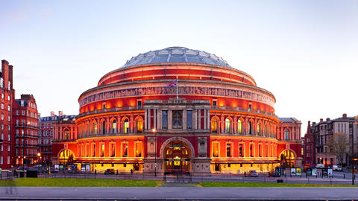
History
It has been built in the time of Queen Victoria
It is named after Prince Albert , her husband, who died in 1861 of thiphoid
On 25 February 1871 the first concert was held to 7000 workers, their families and other invited public to test the acoustics
On 29 March 1871 the Prince of Wales declared the Hall officially open

Slide 23
LONDON EYE

Slide 24
The London Eye is a giant Ferris wheel on the South Bank of the River Thames.
It is the most popular paid tourist attraction in the United Kingdom with over 3.75 million visitors annually.
The London Eye was formally opened on 31 December 1999.
When erected in 1999 it was the world's tallest Ferris wheel.

Slide 25
THE TOWER OF LONDON

Slide 26
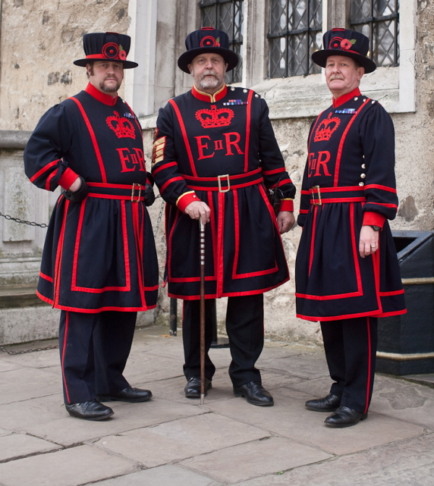
Yeomen warders

Slide 27
The Tower of London is a historic castle located on the north bank of the River Thames in central London.
The White Tower, which gives the entire castle its name, was built during the time of William the Conqueror (900 years ago). It houses the wonderful collection of armour.
Later kings enlarged and fortified the tower., making it, at the same time, a mighty fortress, a palace and a prison.
Today the Queen's Elizabeth's crown and royal treasures are kept in the Wakefield tower.
The guards in the Tower are called Yeomen Warders and are also tourists guides now.
The Tower is home to eight ravens and each of them has a name.

Slide 28
TOWER BRIDGE

Slide 29
The bridge crosses the River Thames close to the Tower of London and has become an iconic symbol of London.
The bridge consists of two bridge towers tied together at the upper level by two horizontal walkways.
The bridge's present colour scheme dates from 1977, when it was painted red, white and blue for Queen Elizabeth II's Silver Jubilee.
Construction started in 1887 and took eight years with five major contractors .
The bridge was officially opened on 30 June 1894 by The Prince of Wales (the future King Edward VII), and his wife, The Princess of Wales (Alexandra of Denmark).

Slide 30
THE MONUMENT

Slide 31
The Monument is a memory of The Great Fire of London. It’s because it almost burned the whole city. The fire began in a baker’s house in Pudding Lane on Sunday 2nd September 1666 and finally stopped on Wednesday 5th September, after destroying the greater part of the City.
It was designed by Christopher Wren in 1666.
The monument is the tallest single stone column in the world and contains a spiral staircase leading to a viewing platform from which you can see some remarkable views of the city.

Slide 32
GLOBE THEATRE

Slide 33
The Globe Theatre was built in 1599 by Shakespeare's playing company, the Lord Chamberlain's Men.
Probably the first performance was the drama Julius Caesar
The fire destroyed it in June 1613. It was rebuilt on the same place in 1614 but it was closed down in 1642 by the Puritans.
In 1997 a modern Globe was opened.
It is an open air theatre and it can house up to 3000 visitors.

Slide 34
HYDE PARK

Slide 35
Hyde Park is one of the largest parks in London and one of the capital’s eight Royal Parks.
It covers 350 acres and is home to a number of famous landmarks including the Serpentine Lake, Speakers’ Corner and the Diana, Princess of Wales Memorial Fountain.
The park was the site of the Great Exibition of 1851.
It has been the venue for some famous rock concerts.
The park also offers various recreational activities including open water swimming, boating, tennis and horse riding.

Slide 36
MADAME TUSSAUDS

Slide 37
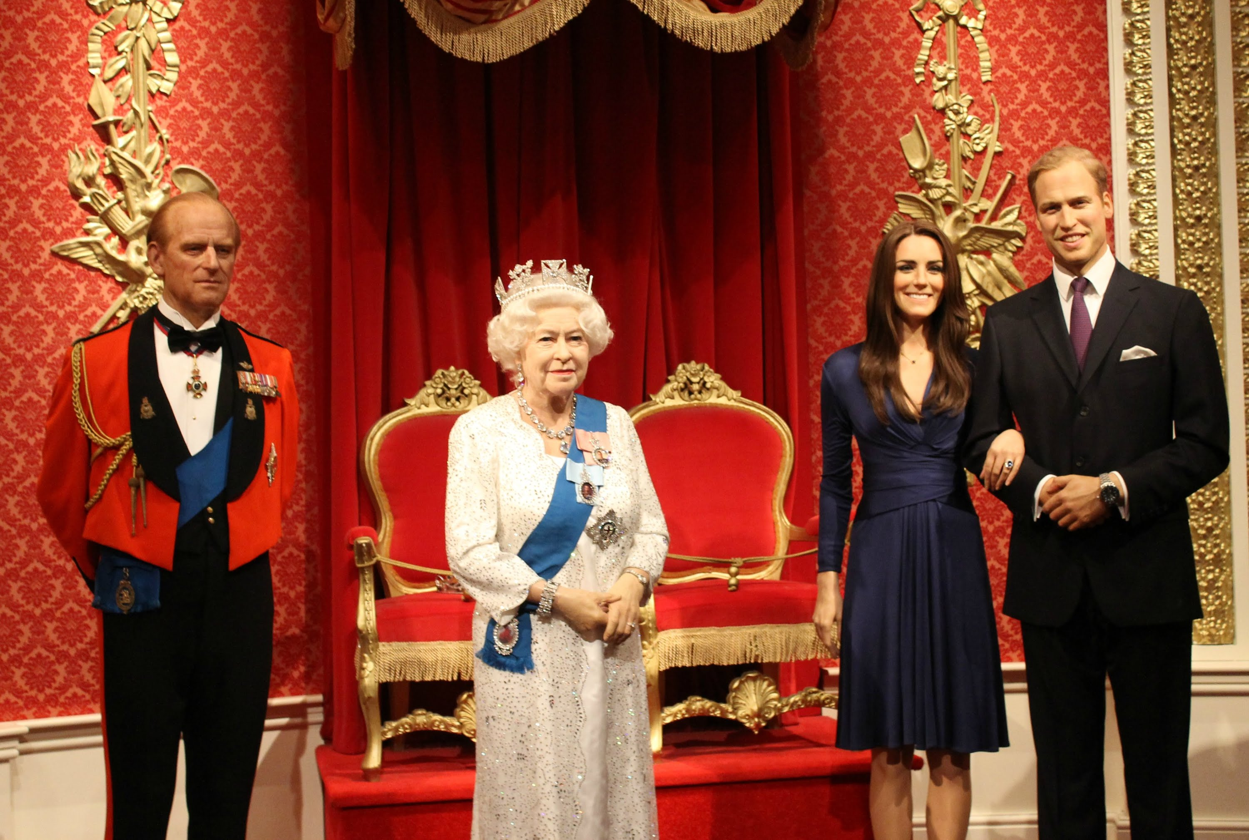
The British Royal Family

Slide 38
Madame Tussauds is a wax museum that was founded by wax sculptor Marie Tussaud in 1835 in Baker Street, London.
It is a major tourist attraction displaying waxworks.
Today’s wax figures at the museum include historical and royal figures, film stars, sports stars and famous murderers.

Slide 39
LONDON ZOO

Slide 40
London Zoo is the world's oldest scientific zoo.
It was opened in London on April 27, 1828.
Today it houses a collection of 756 species of animals, with 17,480 individuals, making it one of the largest collections in the United Kingdom.
The zoo is sometimes called Regent's Zoo.

Slide 41
Pripremili učenici 6.A I 6.B RAZREDA UZ POMOĆ UČITELJICE Gordane Topolnik-jelovica Školska godina 2015./2016.

